Slide 1
Services and Support Offers During Your Studies
Directorate 8 – Student Affairs and Continuing Education
Student Orientation WS 2024/2025

Slide 2
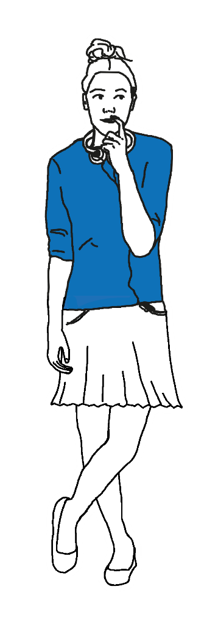
Do you have questions about studying?
What is the best way to study?
Have I chosen the right subject?
Who will help me with my first paper?
Do I already need to apply for an internship?
When and how can I go abroad?
How am I going to manage all of this?
› tud.de/studium/beratung

Slide 3

Dresden University of Technology accompanies and supports you
CENTRAL STUDENT INFORMATION AND COUNSELING SERVICE
… is there for you in difficult situations. Having doubts or facing problems during your studies?
› tud.de/zsb/studienberatung
Offers
Individual Counseling
Workshops
Study Groups
Early Warning System PASST?!

Slide 4

Dresden University of Technology accompanies and supports you
ADMISSIONS OFFICE
… if you were educated in Germany
› tud.de/imma
INTERNATIONAL OFFICE
… for international students
› tud.de/international
Topics
Re-registration for the following semester, De-registration, Certificates
Taking a leave of absence
Changing degree programs

Slide 5

Dresden University of Technology accompanies and supports you
Gaining international experience
International Office
Incoming
International Tutoring Program
Cultural Office
Outgoing
Study abroad
› tud.de/international
LEONARDO-BÜRO SACHSEN
Internship abroad
› tud.de/leonardo

Slide 6

Dresden University of Technology accompanies and supports you
CAREER SERVICE
Topics & Offers
Key Competencies
Presenting skillfully
Applying successfully
CV Check
Career Counseling
Live Streams with employers
Jobs and Internships
On-Campus Jobfairs
Career Orientation
› tud.de/career

Slide 7


Dresden University of Technology and its partners will accompany and support you with numerous other offers:
Study Success Projects
tud.de/deinstudienerfolg
Studentenwerk Dresden
studentenwerk-dresden.de
Student Council
tud.de/stura
tud.de/stura/fachschaften
Counseling Compass
tud.de/studium/beratungskompass
Student Advisory Service
tud.de/studienfachberatung

Slide 8

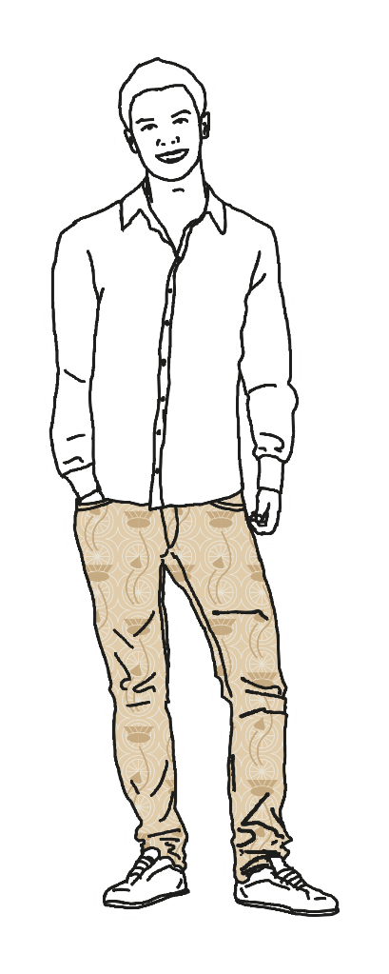
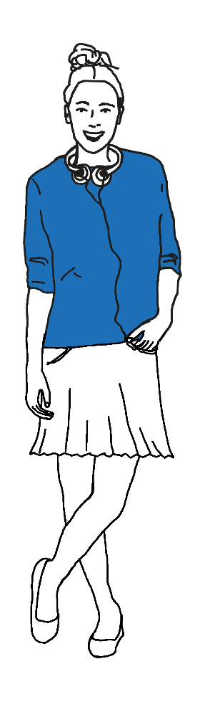

We are here to help!
= scs@tu-dresden.de
& +49 351 463 42000
› tud.de/studium/beratung

