Slide 1
Title of the Presentation
First name Last name
Faculty of Business Administration and Economics, Chair of Business Administration, esp. Logistics
Subtitle of the Presentation

Slide 2
Outline element

Slide 4
Colours Basic colours and variants
Name rgb hex
HKS 41 0 / 48 / 94 #00305d
HKS 44 0 / 106 / 179 #006ab2
Cyan 0 / 158 / 224 #009de0
HKS 92 114 / 119 / 119 #717778
HKS 33 147 / 16 / 126 #93107d
HKS 36 84 / 55 / 138 #54368a
HKS 65 106 / 176 / 35 #69af22
HKS 57 0 / 125 / 64 #007d3f
HKS 07 238 / 127 / 0 #ee7f00
The TU Dresden's corporate colour is dark blue, HKS 41.
In addition, a range of secondary colours defined.
The colours can be used in different opacities.
The colours are integrated directly into this presentation template.
You can create colour palettes using the following file path in your system for Office.
C:\Users\..................\AppData\Roaming\Microsoft\Templates\Document Themes\Theme Colors

Slide 5
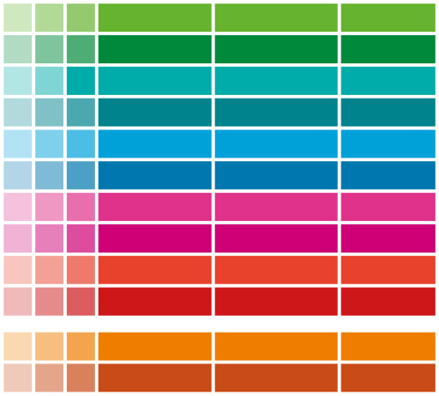
Colour Colour Assignment of Areas and Study Information System
 |  |  | Designation | rgb | Hex
 |  |  | MN bright | 101 / 179 / 46 | #65b32e
 |  |  | MN dark | 0 / 137 / 58 | #00893a
 |  |  | BuU bright | 0 / 172 / 169 | #00aca9
 |  |  | BuU dark | 0 / 131 / 141 | #00838d
 |  |  | ING bright | 0 / 161 / 217 | #00a1d9
 |  |  | ING dark | 0 / 119 / 174 | #0077ae
 |  |  | GSW bright | 224 / 49 / 138 | #e0318a
 |  |  | GSW dark | 206 / 0 / 117 | #c40075
 |  |  | MED bright | 232 / 65 / 44 | #e8412c
 |  |  | MED dark | 205 / 23 / 25 | #cd1619
 |  |  | LEH bright | 239 / 125 / 0 | #ef7d00
 |  |  | LEH dark | 201 / 75 / 23 | #C94B17
The following colours are assigned to the five areas of the TUD.
For the Study Information System (SINS), equivalent colours apply to the SINS areas
+ additionally the orange for the SINS area of Teaching.

Slide 6
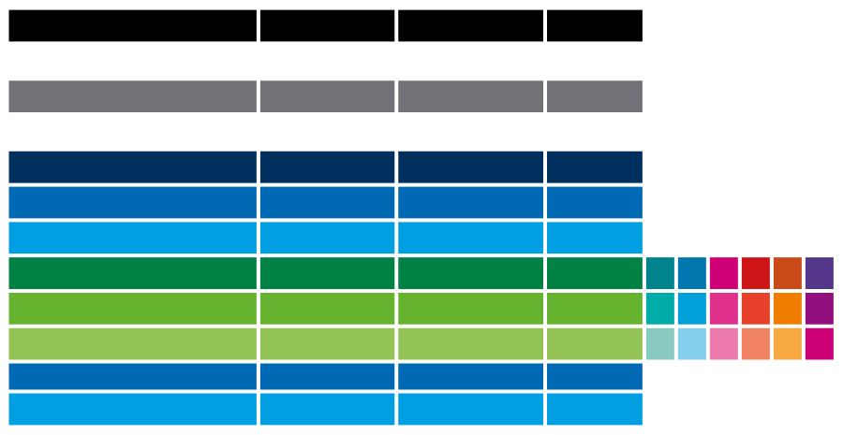
Colour Colour palettes in Office
Office colour range | Designation | rgb | Hex
Text/background -dark - 1 | Black | 0 / 0 / 0 | #000000
Text/background -light - 1 | White | 255 / 255 / 255 | #FFFFFF
Text/background -dark - 2 | Grey (HKS 92) | 114 / 119 / 119 | #727777
Text/background -light - 2 | White | 255 / 255 / 255 | #FFFFFF
Accent 1 | Blue HKS 41 | 0 / 48 / 93 | #00305d
Accent 2 | Blue HKS 44 | 0 / 106 / 179 | #006ab2
Accent 3 | Cyan | 0 / 158 / 224 | #009de0
Accent 4 | Dark green | 0 / 137 / 58 | #00893a
Accent 5 | Medium green | 101 / 179 / 46 | #65b32e
Accent 6 | Light green
Hyperlink | Blue HKS 44 | 0 / 106 / 179 | #006ab2
Visited hyperlink | Cyan | 0 / 158 / 224 | #009de0
The accent colour 4-6 changes in the colour palettes for Office (stored as .xml file).

Slide 7
Diagrams monochrome
Recommended display parameters:
Preference for flat diagrams (no 3D!)
Use monochrome colour variants, preferably in cyan Alternatively, a different contrast colour can also be defined for the document.
Labelling outside the surfaces
do without shadows, gradients etc.

Slide 8
Diagrams multicoloured
If multi-coloured diagrams are required for specific topics:
Use a consistent colour scheme throughout the document
Adapt the colour scheme to your own needs e.g.
DRESDEN-concept Colours
Colours of the SINS (Study Information System of the TUD)
Colours of your own Structural Unit

Slide 9
Infographics via Smartart
Recommended display parameters:
Reduce text content
Favour flat variants
Consistent colours throughout the document
Note colour contrasts and font sizes
do without shadows, gradients etc.
Create complex graphics as separate vector graphics (e.g. with Inkscape)
Background information
with 3 or 4 aspects
Note font size
Background information
with 3 or 4 aspects
Note font size
1 Topic
2 Topic
Topic 3
Integrate new topic
Emphasise the important
Background information
with 3 or 4 aspects
Note font size

